Slide 1




NEXT GEN EMPLOYABILITY PROGRAM
Creating a future-ready workforce
Team Members
College Name
Student Name : Tmail Selvan.M
Student ID : 623521104058
6235 - AVS College of Technology

Slide 2

CAPSTONE PROJECT SHOWCASE
Project Title
Building Bus Reservation System using Python and Django
Abstract | Problem Statement | Project Overview | Proposed Solution | Technology Used | Modelling & Results | Conclusion

Slide 3
Abstract
Aimed at facilitating the booking and management of bus tickets, providing convenience and efficiency to users.
The Bus Reservation System (BRS) is a web-based application developed using Python and Django framework.
Key features include user registration/authentication, bus and route management, seat reservation, payment integration, and reservation management.
Source :

Slide 4
Problem Statement
Passengers face difficulty in accessing accurate and up-to-date information about available buses, routes, and seat availability, hindering effective travel planning.
Existing bus reservation systems suffer from inefficiency and lack of convenience, posing challenges for both passengers and bus operators.
Booking processes are often complex and time-consuming, leading to inconvenience for passengers and potential loss of business for operators.
Source :

Slide 5
Project Overview
The Bus Reservation System (BRS) is a web-based application developed using Python and Django framework, aiming to streamline the booking process and enhance the management of bus reservations.The primary goal of the project is to create a user-friendly and efficient platform for booking bus tickets, providing accurate information to passengers, and empowering bus operators with effective management tools.
Source :

Slide 6
Proposed Solution
Develop a comprehensive Bus Reservation System (BRS) using Python and Django framework to streamline the booking process and enhance reservation management.
Key Components:
User Management
Bus and Route Management
Reservation Management
Admin Dashboard
Source :

Slide 7


Technology Used
Front-end
Back-end
Source :

Slide 8
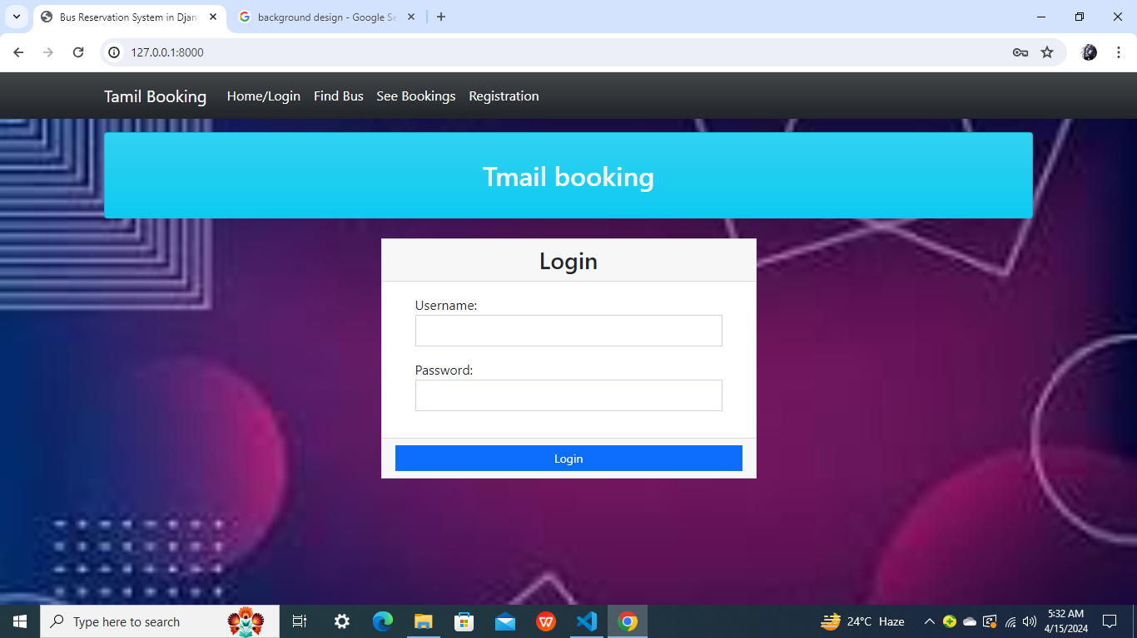
Modelling & Results
Source :

Slide 9
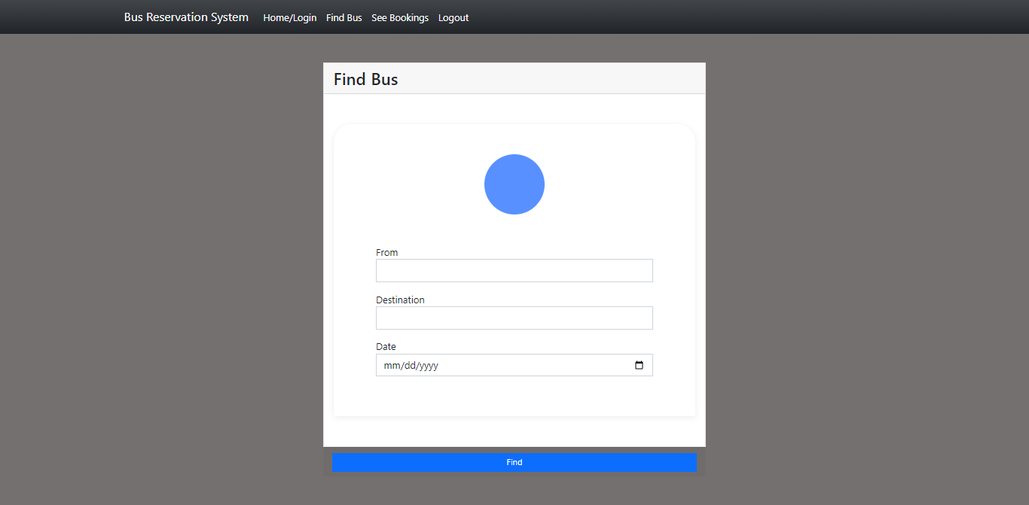
FIND BUS

Slide 10
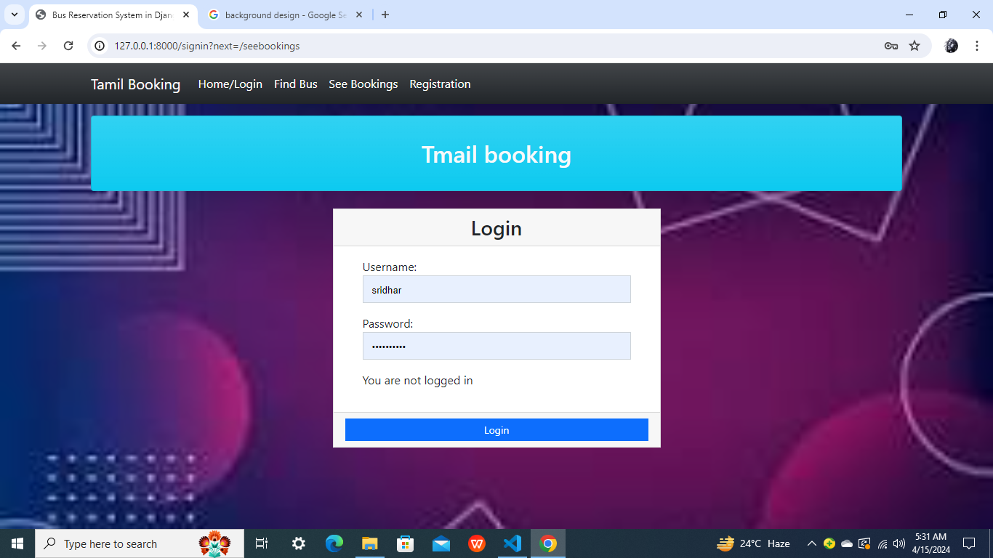
HOME PAGE

Slide 11
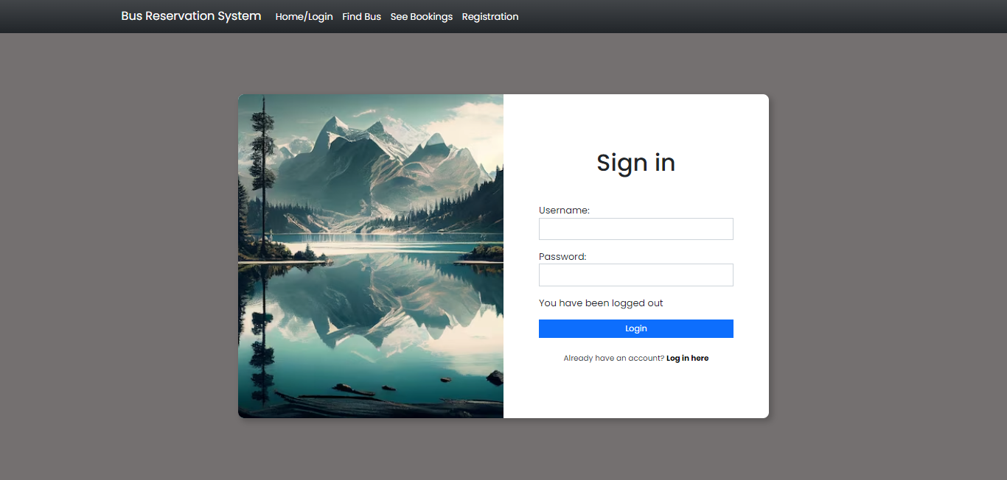
LOGIN PAGE

Slide 12
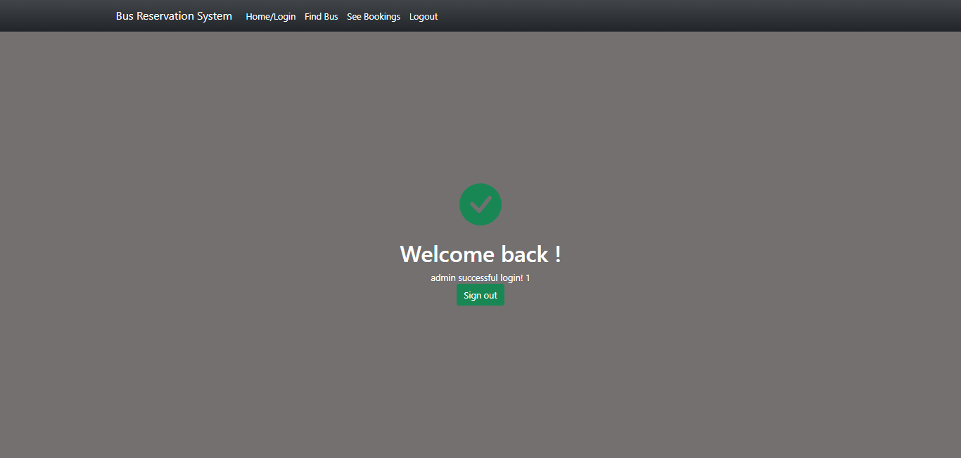
THANKS PAGE

Slide 13
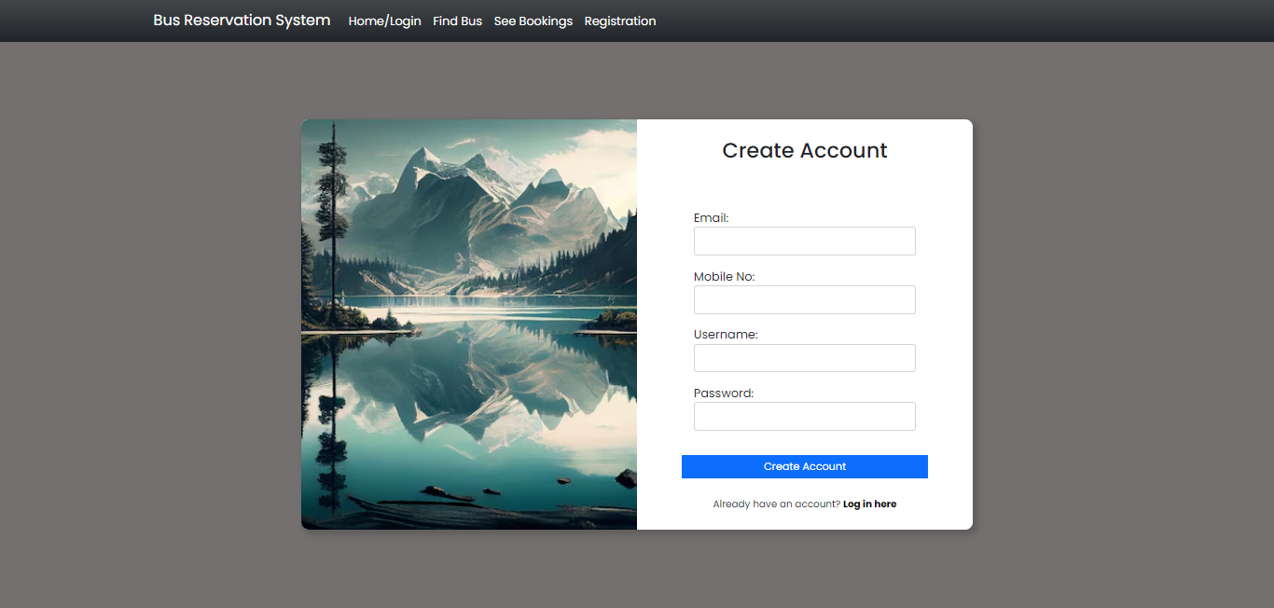
REGISTRATION PAGE

Slide 14
Future Enhancements:
Implement a feedback system for users to provide reviews.
Enhance accessibility features for users with disabilities.
Introduce QR code or RFID-based ticketing systems.
Promote environmental initiatives for sustainable travel.

Slide 15
Conclusion
In conclusion, the proposed Bus Reservation System (BRS) offers a comprehensive solution for efficient bus ticket booking and management.
Source :

Slide 16
Thank You!
Notes:
Thank You !!

